Slide 1

BACHELOR OF TECHNOLOGY
IN
Artificial Intelligence and Machine Learning
Batch Number:GT-05
Project Guide : A.KiranKumar
Batch Names & Roll Numbers K.Jagadish(2111CS020181) R.Jyoshna(2111CS020194)
B.Jyothi(2111CS020195)
Rithika.J.Poojari(2111CS020196) B.Karthik Goud(2111CS020198) Mohit Kumar (2111CS020232)
Department of AIML, School of Engineering
Malla Reddy University

Slide 2
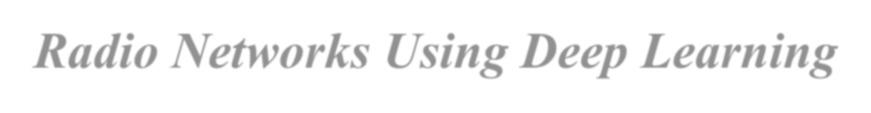
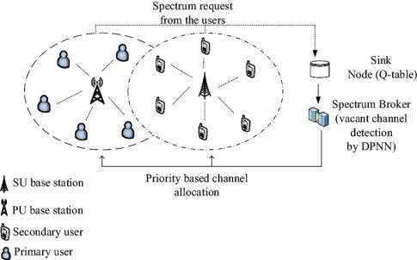
Dynamic Spectrum Allocation in Cognitive Radio Networks Using Deep Learning

Slide 3
INTRODUCTION
Growing Demand: The rapid advancement of wireless communication has increased the need for
efficient spectrum management.
Static Allocation Issues: Traditional static spectrum allocation leads to underutilization, even as
demand for bandwidth rises.
Cognitive Radio (CR) Solution: CR technology enables dynamic access to underused frequency
bands, improving spectrum utilization.
Decentralized Approach: This project proposes a decentralized system where each user selects channels independently, reducing the need for centralized management.
Enhanced Performance: By using advanced learning techniques, this approach reduces
interference and improves network capacity, addressing spectrum scarcity.

Slide 4
Problem Definition
Problem: Limited available spectrum (frequency) for wireless communication,
which leads to network congestion and interference.
Goal: Allow multiple users to share spectrum efficiently by letting them pick
channels on their own, without a central authority controlling them.
Challenges:
Users need to select channels without interfering with each other.
The network conditions keep changing, so the solution must adapt quickly.
Solution Approach: Use machine learning and deep learning to help each user choose the best channel based on current network conditions.
Expected Outcome: Better use of available spectrum, reduced interference, and improved network performance.

Slide 5
Objective of Project
Objective: Develop a decentralized dynamic spectrum access method for multi-user wireless networks.
Efficient Spectrum Management: Improve spectrum utilization, reduce interference, and increase system capacity.
Machine Learning Techniques: Use algorithms like Machine Learning,Q-learning, DQN, and Reinforcement Learning for optimization.
Real-Time Adaptation: Enable real-time channel selection that adapts to changing network conditions.
Enhanced Network Performance: Minimize conflicts between users and boost overall network performance.

Slide 6
Scope of Project
Decentralized Framework: Develop a system where users select channels independently, reducing centralized management complexity.
Algorithm Integration: Use Machine LearningQ-learning, DQN, and Reinforcement Learning to optimize real-time channel selection and adapt to network changes.
Enhanced Performance: Improve spectrum utilization, reduce interference, and increase system capacity
through intelligent channel selection.
Simulation and Validation: Test the proposed system through simulations to ensure effectiveness in reducing
interference and boosting efficiency.
Future Applications: Apply this approach to emerging networks like 5G/6G, IoT, and cognitive radio, where
dynamic spectrum management is essential

Slide 7
ANALYSIS
Project Planning and Research
Objective: Develop a decentralized dynamic spectrum access system using deep learning to enhance wireless
communication efficiency.
Project Planning: Conduct a literature review, select algorithms (like Machine Learning and Genetic Algorithms), and create a timeline with milestones and team roles.
Data Collection and Preprocessing: Gather and prepare historical and simulated spectrum data for analysis.
Model Testing and Evaluation: Experiment with different model architectures and use simulations to assess
improvements in spectrum utilization and interference reduction.
Project Conclusion: Compile findings in a final report, with recommendations for applications in 5G and IoT
technologies.

Slide 8
Model Selection and Architecture
The model uses a hybrid approach with Genetic Algorithm (GA) for dynamic
spectrum allocation in cognitive radio networks.
GA optimizes channel reallocation during conflicts, selecting channels to minimize disruption
between primary and secondary users.
This decentralized architecture allows users to select channels independently and adapt to
network changes.
The hybrid model enhances capacity, reduces interference, and improves overall network performance.

Slide 9
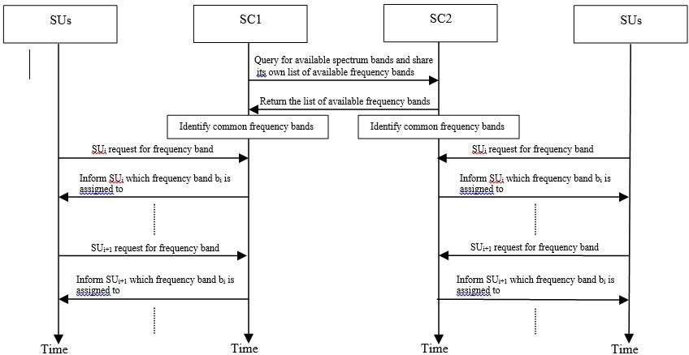
Architecture

Slide 10
Data Set Descriptions
In our project, we utilize a dataset composed of two primary 100x100 matrices: the Channel Matrix and the Reward
Matrix.
1.Channel Matrix: This matrix represents the availability and quality of communication channels across the network. Each entry in the matrix corresponds to a specific channel's status for a given user, where values indicate the channel's condition—ranging from 0 (unavailable or poor quality) to 1 (fully available or excellent quality). This structure allows our system to analyze and assess which channels are optimal for each user based on their communication needs and the interference levels present in the environment.
2. Reward Matrix: This matrix is used to evaluate the effectiveness of channel selections made by users. Each
entry corresponds to a calculated reward associated with using a particular channel at a specific time, reflecting metrics such as throughput, signal strength, and user satisfaction. The values in the Reward Matrix guide the learning algorithms, helping them understand the consequences of channel choices and improving decision-making over time.

Slide 11
Data Preprocessing Techniques
Normalization: We scale the values of the channel and reward matrices to a range of 0 to 1, ensuring that all
features contribute equally to model training.
Handling Missing Values: Missing entries in the matrices are addressed through imputation, filling gaps with the mean or median to maintain dataset integrity.
Data Transformation: We apply transformations, such as log transformations, to reduce skewness in the
reward data, making it more suitable for analysis.
Dimensionality Reduction: Techniques like Principal Component Analysis (PCA) may be used to simplify
the dataset, retaining the most informative features while reducing computational complexity.
Encoding Categorical Variables: If any categorical data is present, we use one-hot encoding to convert it into
a numerical format for model compatibility.
Data Splitting: The dataset is divided into training, validation, and test sets (typically in an 80/10/10 ratio) to
ensure robust model evaluation.
Outlier Detection: We identify and handle outliers using statistical methods to avoid skewing the results.

Slide 12
Methods & Algorithms
NumPy: A fundamental Python package for numerical computing, supporting large arrays, matrices, and
mathematical functions for efficient scientific computing.
Matplotlib: A versatile plotting library that enables static, animated, and interactive visualizations. The pyplot
module offers an easy interface for creating and customizing plots.
Pandas: A powerful library for data manipulation and analysis, providing DataFrames for structured data handling, with easy reading, writing, and preparation of data for analysis.
Genetic Algorithm (GA): An optimization technique inspired by natural selection, with steps including:
Initialization: Generate a population of random solutions.
Fitness Evaluation: Calculate a fairness score using calculate_proportional_fairness.
Selection: Use tournament selection for reproduction.
Machine Learning Algorithms:
Logistic Regression: Linear model for classification.
Decision Tree: Splits data using feature values.
Random Forest: Ensemble of Decision Trees.
Knn: Classifies by nearest neighbours.

Slide 13
Model Implementation and Training
The project uses a hybrid model with Genetic Algorithms (GA) and Machine Learning Algorithms (ML) to optimize channel selection in cognitive radio networks.
The GA starts by initializing a population of channel allocations, evolving them through selection,
crossover, and mutation based on metrics like MMR, MSR, and MPF.
The ML is trained with historical and real-time data to predict optimal channel usage and adapt to user requirements.
Training uses backpropagation and optimization to reduce prediction errors and adapt to network
changes.
This approach enhances spectrum utilization and scalability, providing a robust solution for real-time
spectrum management.

Slide 14
Model Evaluation Metrics
Maximum Minimum Rate (MMR): Evaluates the lowest throughput across all users to
ensure minimum quality of service.
Maximum Signal Range (MSR): Assesses the farthest distance for effective
communication, indicating coverage optimization.
Maximum Proportional Fairness (MPF): Measures fairness in resource allocation by
balancing throughput and user satisfaction.
Channel Utilization: Tracks the efficiency of spectrum usage by minimizing conflicts.
Interference Levels: Evaluates the model's ability to reduce interference between users.

Slide 15
Results: Testing and Validation
Rigorous testing and validation to assess real-world performance.
Simulations under various network conditions (user densities, interference levels).
Validation using a testing dataset to verify dynamic spectrum allocation and efficiency.
Monitoring key metrics: channel utilization, interference rates, and user satisfaction.
Cross-validation for robustness and generalizability across diverse environments.

Slide 16
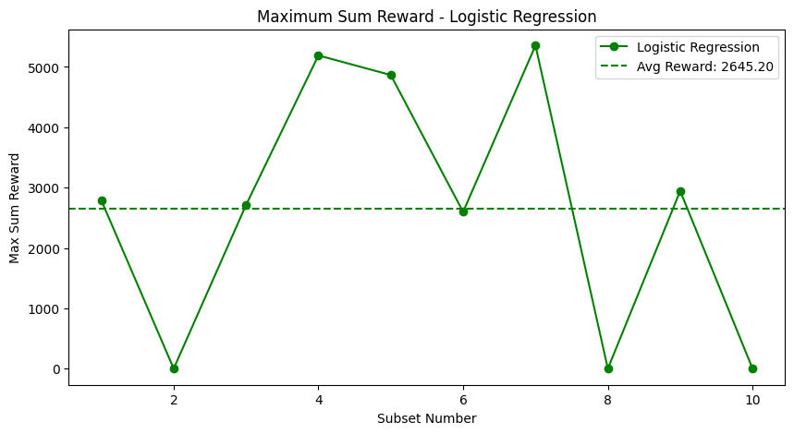
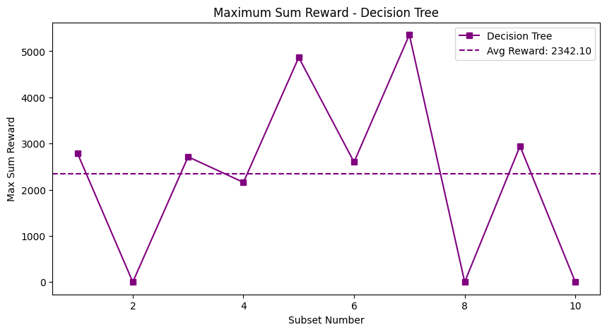
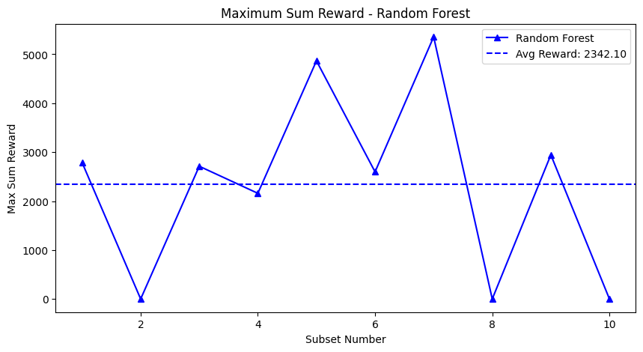
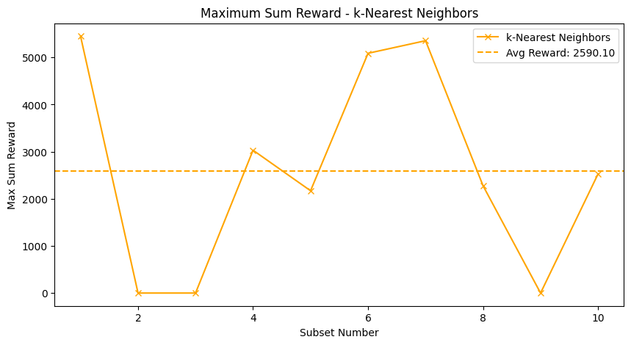
MSR(10*10)

Slide 17
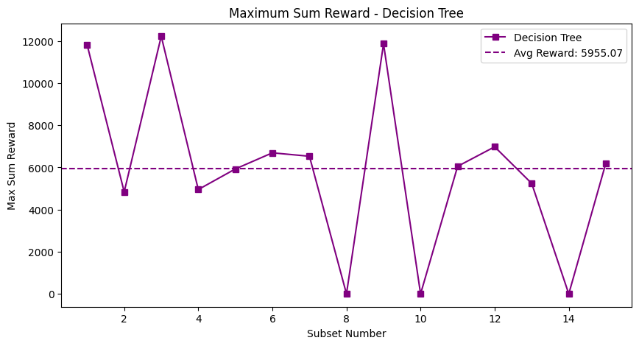
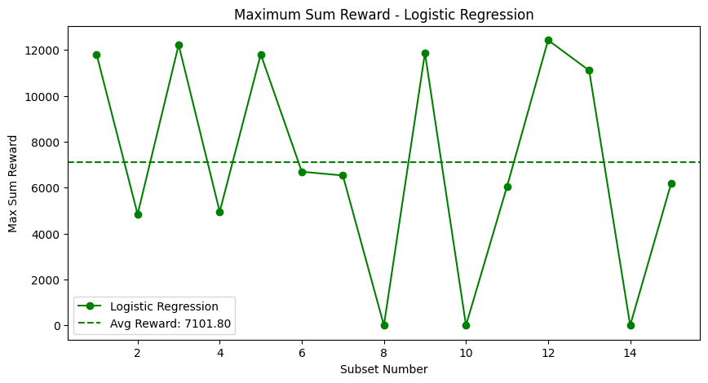
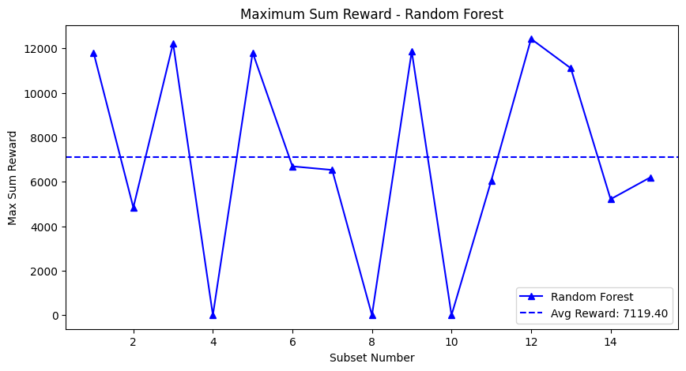
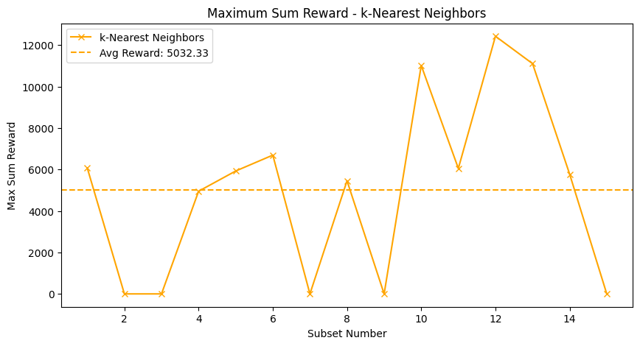
MSR(15*15)

Slide 18
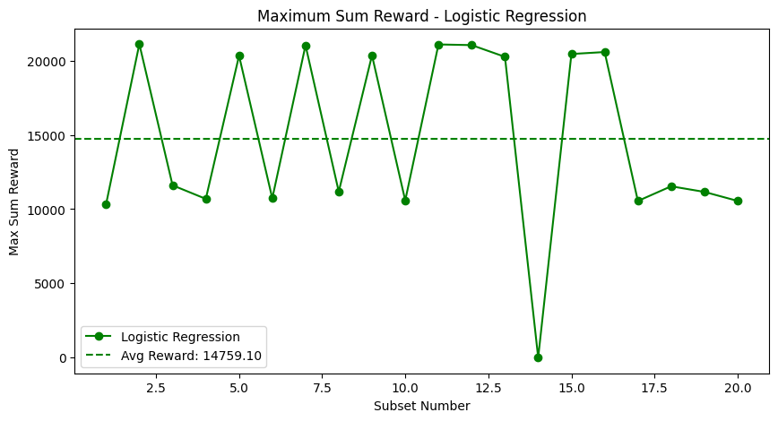
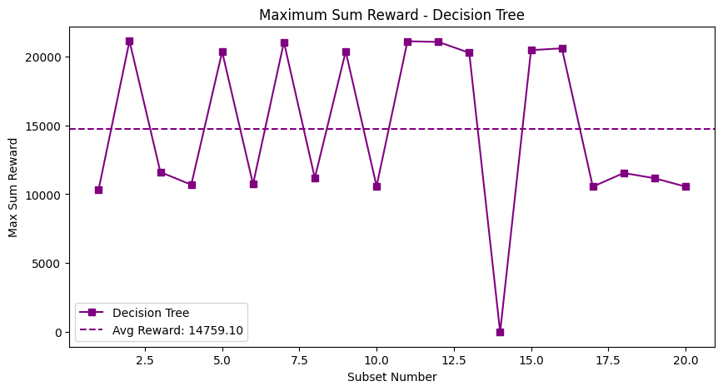
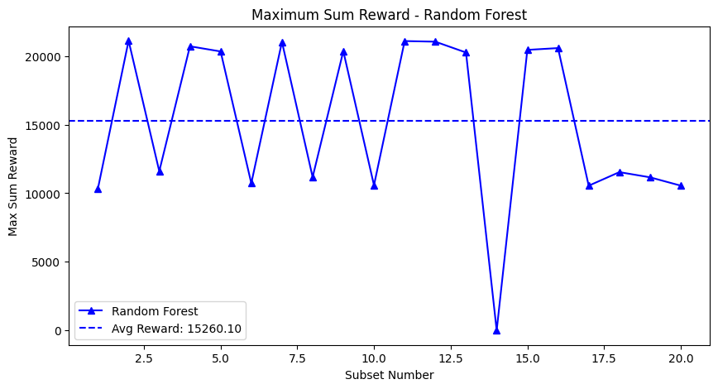
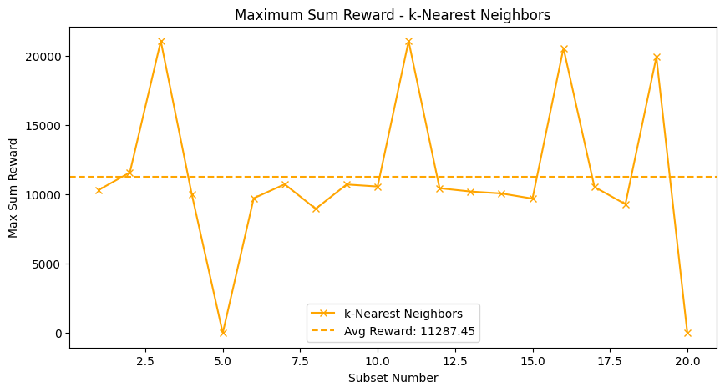
MSR(20*20)

Slide 19
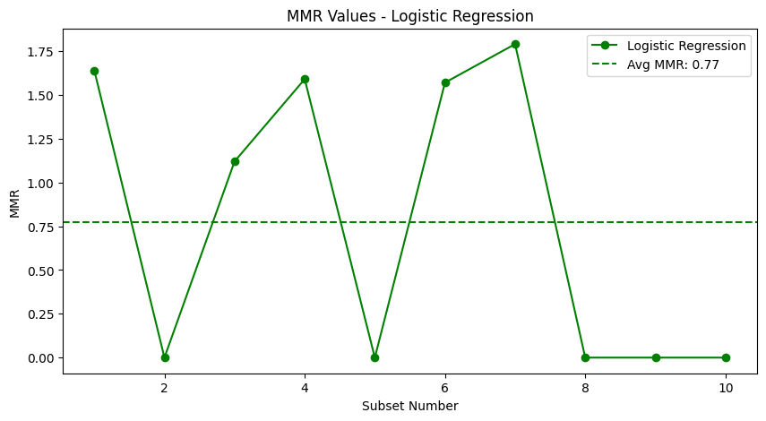
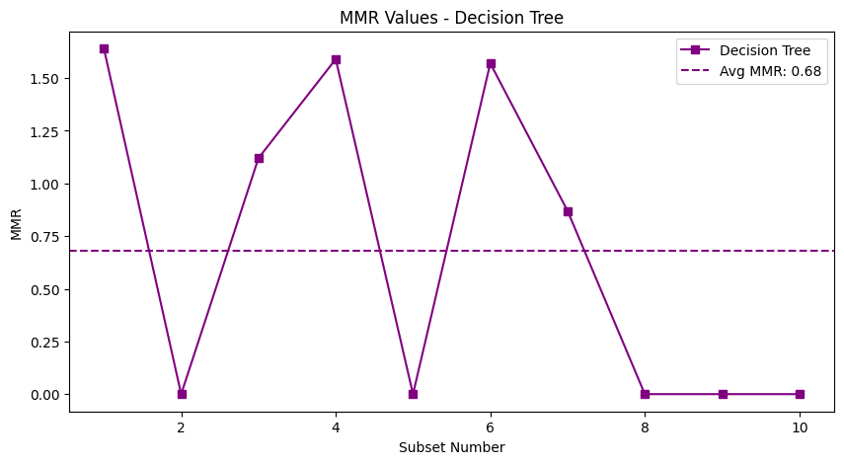
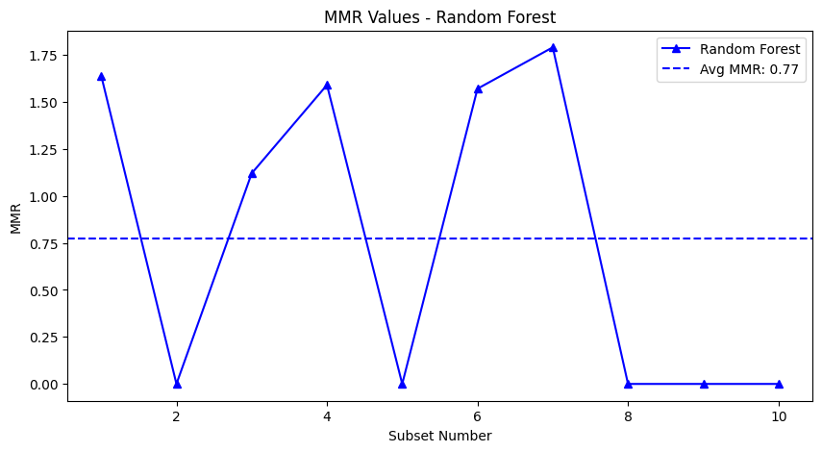
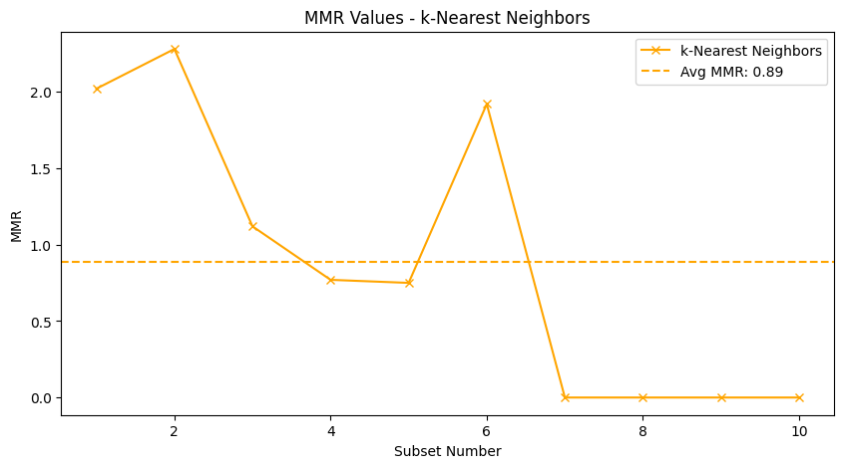
MMR(10*10)

Slide 20
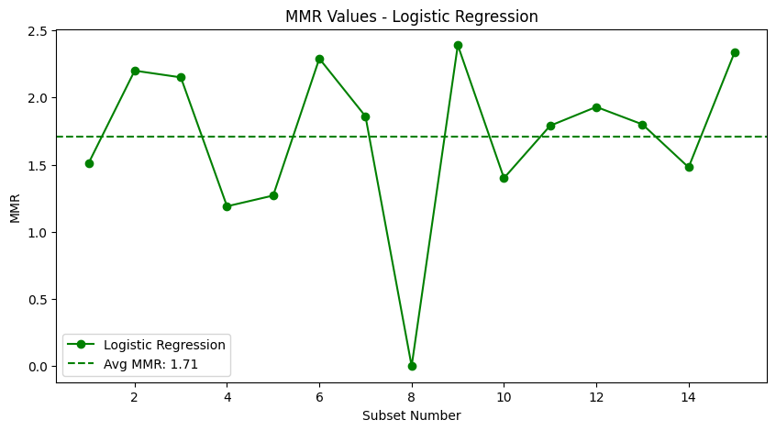
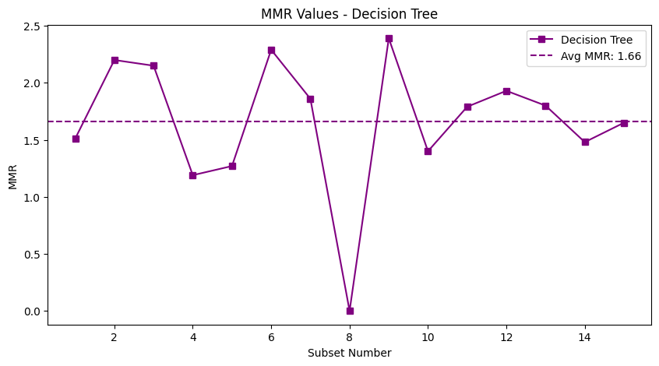
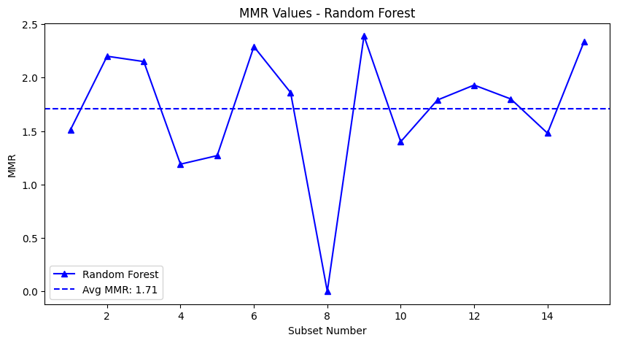
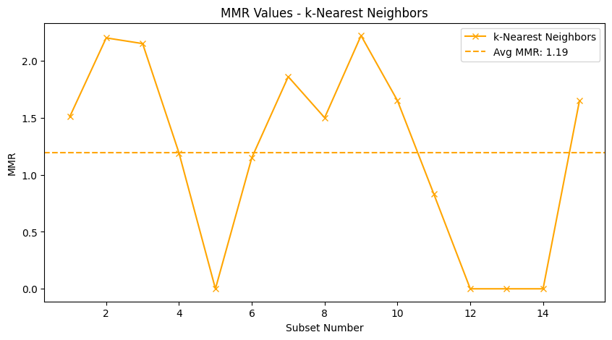
MMR(15*15)

Slide 21
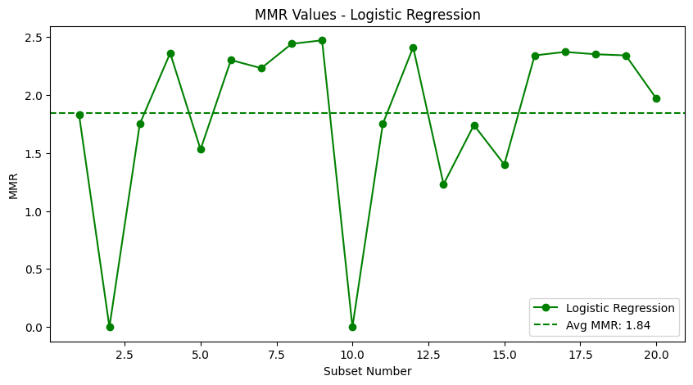
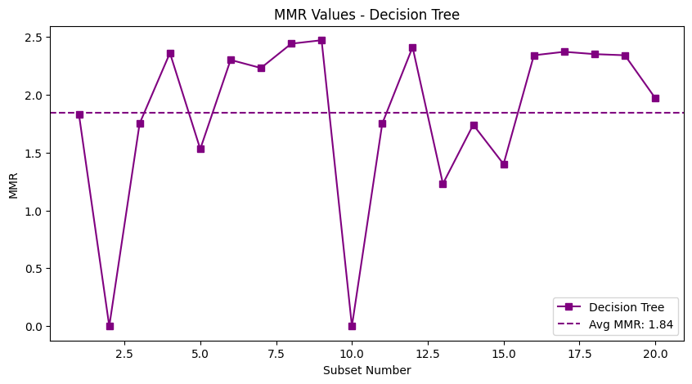
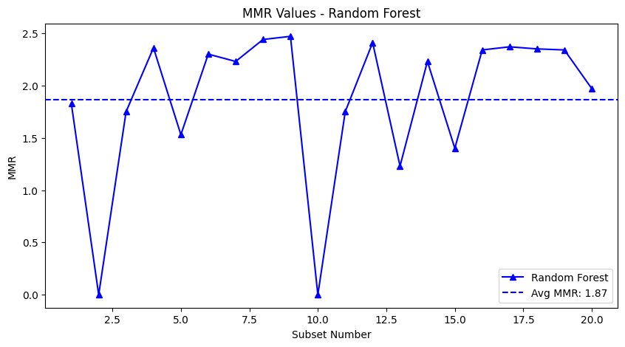
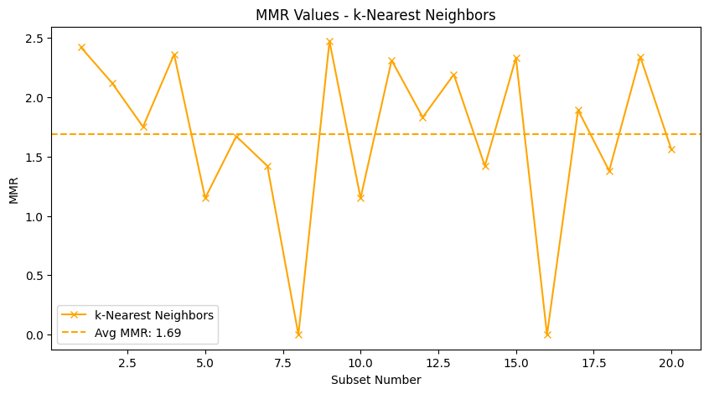
MMR(20*20)

Slide 22
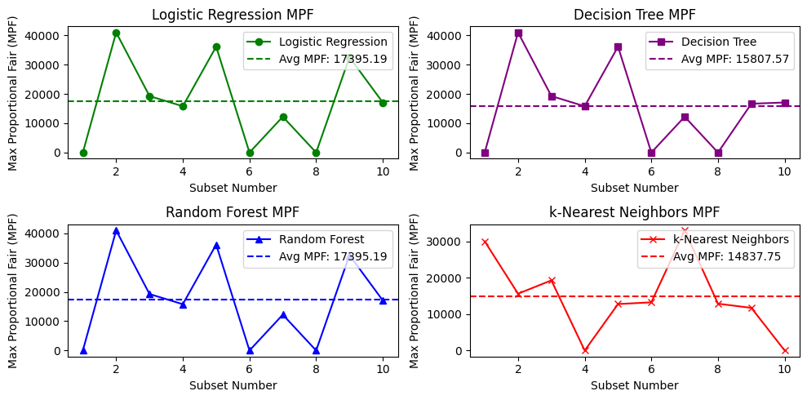
MPF(10*10)

Slide 23
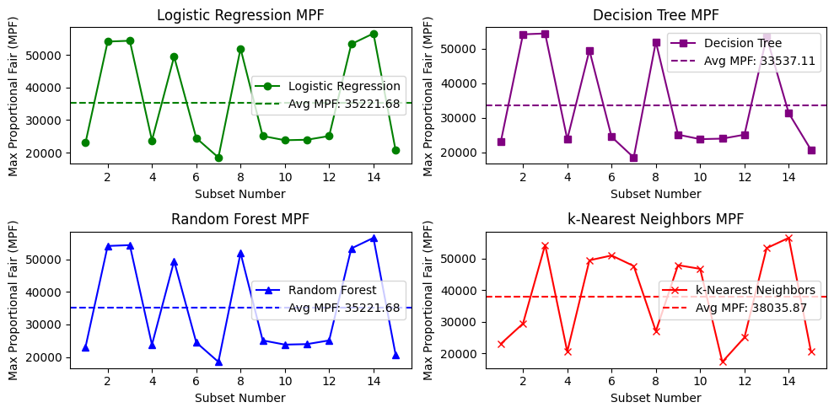
MPF(15*15)

Slide 24
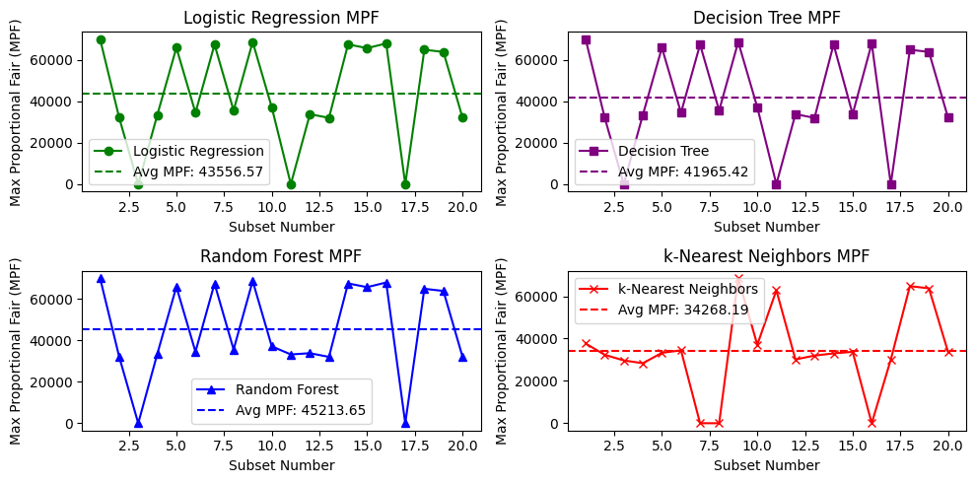
MPF(20*20)

Slide 25
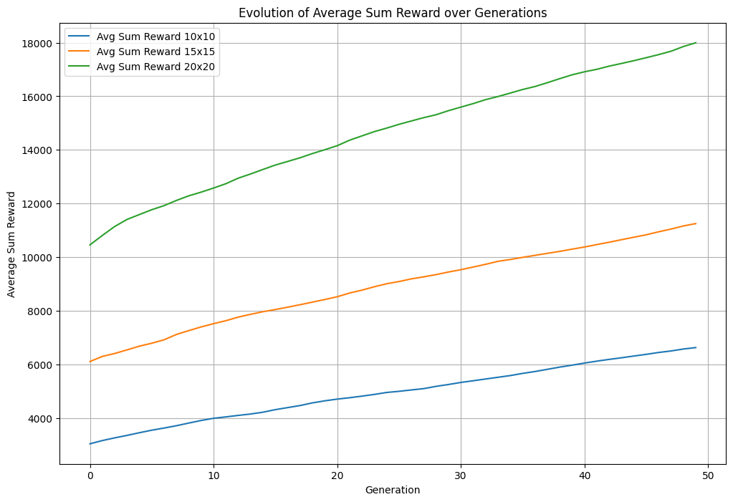
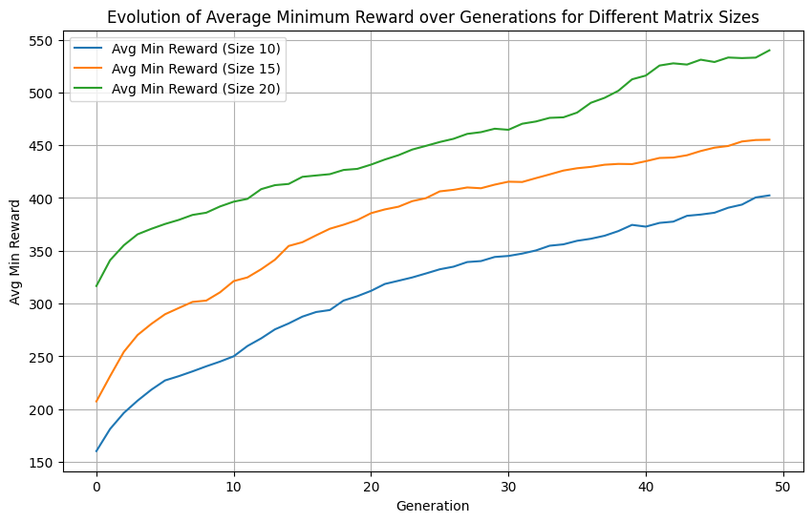
Plots of (10*10,15*15,20*20 using Genetic Algorithm
MSR
MMR

Slide 26
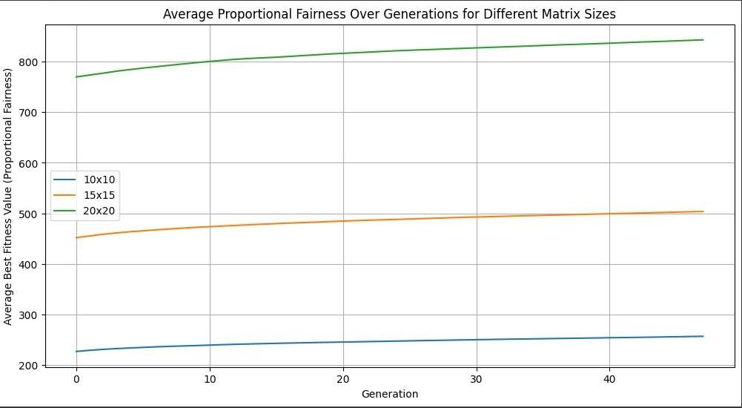
MPF

Slide 27
Conclusion
The project optimized spectrum allocation in Cognitive Radio (CR) networks using Genetic Algorithms (GA) and Machine Learning (ML) models.
Utility functions like MSR, MMR, and MPF evaluated their performance.
GA excelled in multi-objective optimization and real-time adaptability.
KNN and Random Forest performed well in fairness tasks but lacked adaptability to dynamic environments.
GA is recommended for spectrum allocation in next-gen systems like 6G and IoT.

Slide 28
Future Scope
Integration with Emerging Technologies: Expand the model to support 5G and future wireless
communication technologies to meet the increasing demand for spectrum efficiency.
Advanced Machine Learning Techniques: Incorporate techniques such as transfer learning and
ensemble methods to improve adaptability and performance in varied network conditions.
IoT Applications: Adapt the system for Internet of Things (IoT) environments, optimizing
spectrum management for smart cities and industrial automation scenarios.
Real-Time Data Analytics: Implement real-time analytics and feedback loops to enable
proactive spectrum allocation adjustments in response to dynamic network changes.
Security Measures: Explore and develop robust security protocols to protect against vulnerabilities in decentralized spectrum management, ensuring reliable operation across different contexts.

Slide 29


